Slide 1

Classifying SMS as Spam or Ham
Subject: Machine Learning Frameworks

Slide 2
Team Members
Paul Udayan Gomez Jayaprakash - 200595039
Udaya Kumar Siva Kumar - 200610016
Ghassan Saba - 200629398
Aishwariya Balaji - 200584439

Slide 3

Problem & Objective
Problem:
Every day, millions of SMS messages are sent, with a significant portion being spam unwanted messages promoting offers, scams, or fraudulent schemes.
Spam messages can lead to:
Security risks (phishing links, malware).
Wasted time for users.
Distrust in mobile communication.
Filtering spam is challenging because:
Spam messages constantly evolve in wording and style.
Overly aggressive filters can cause false positives, blocking important legitimate messages.
Objective:
Build an intelligent model that:
Accurately classifies incoming messages as Spam or Ham (Not Spam).
Minimizes false positives so legitimate messages aren’t blocked.
Works efficiently enough for real-time deployment in an SMS service.
Deploy the model through a REST API (Flask) so it can be easily integrated into messaging platforms or security applications.

Slide 4
Data Collection & Preparation
Checked for missing values and removed any empty or duplicate rows to make sure our dataset was clean and reliable.
Trimmed the message text to remove extra spaces and applied a consistent text format for better processing.
Encoded categorical labels:
ham → 0 (Not Spam)
spam → 1 (Spam)
Performed an 80/20 train–test split using stratify to maintain the original spam to ham ratio.
Ensured the dataset was clean, structured, and balanced for effective EDA and modeling.
Imported the spam.csv dataset using latin-1 encoding so that special characters could be read properly without any decoding errors

Slide 5
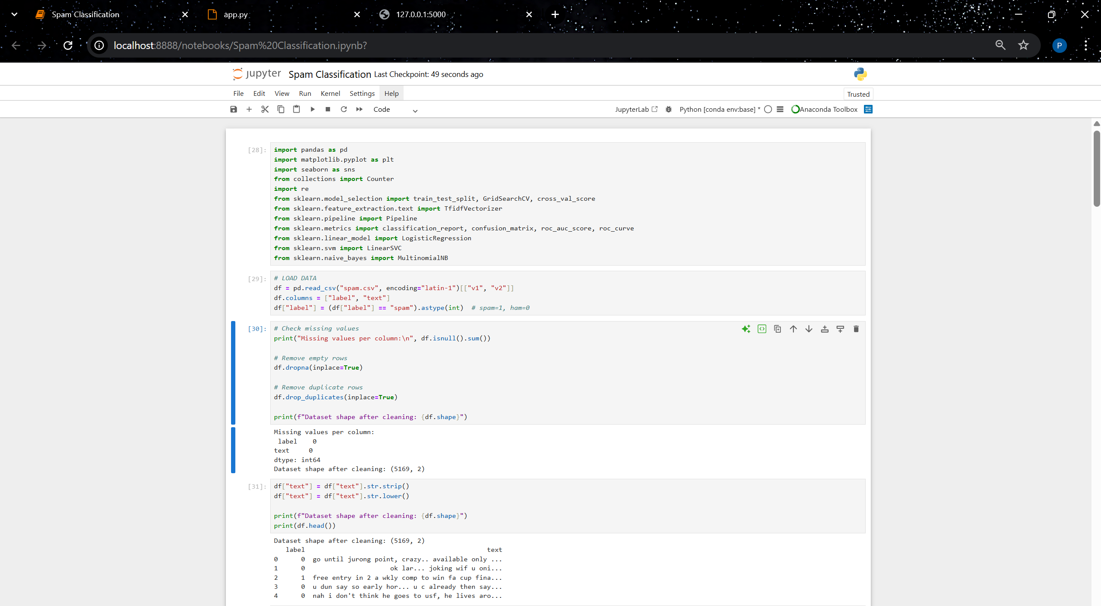
Data Preprocessing

Slide 6
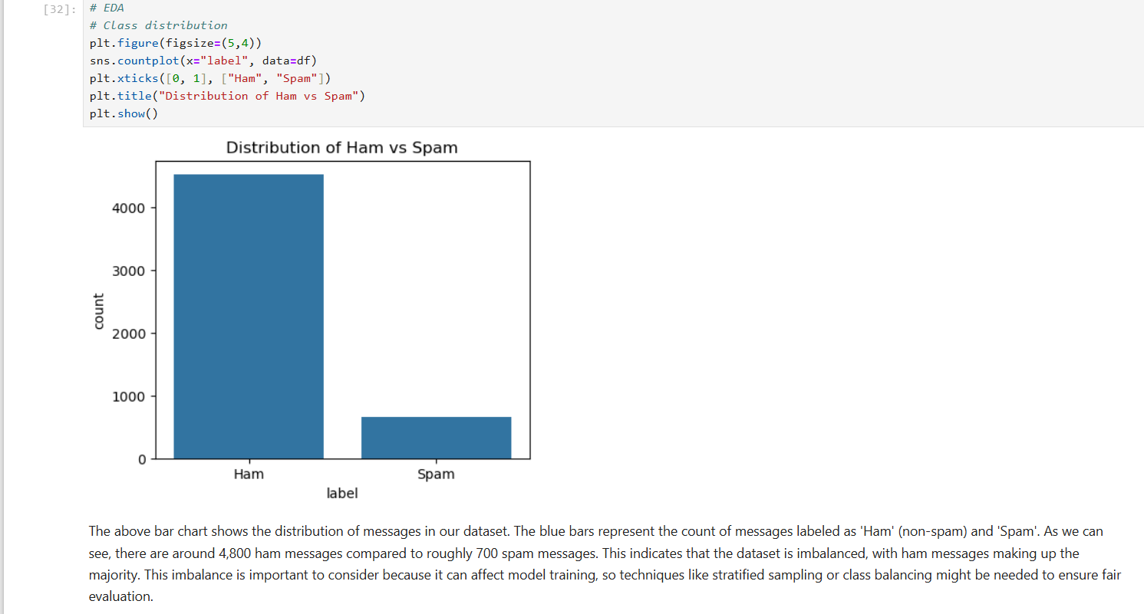
Exploratory Data Analysis

Slide 7
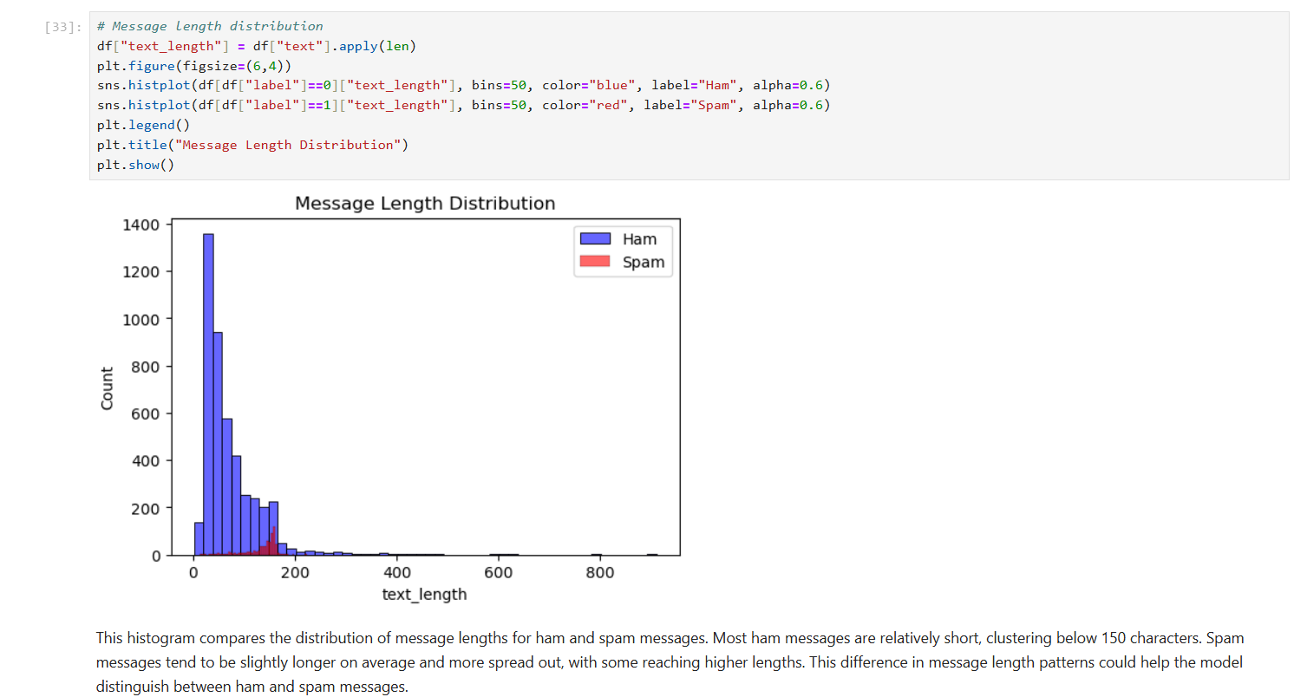

Slide 8
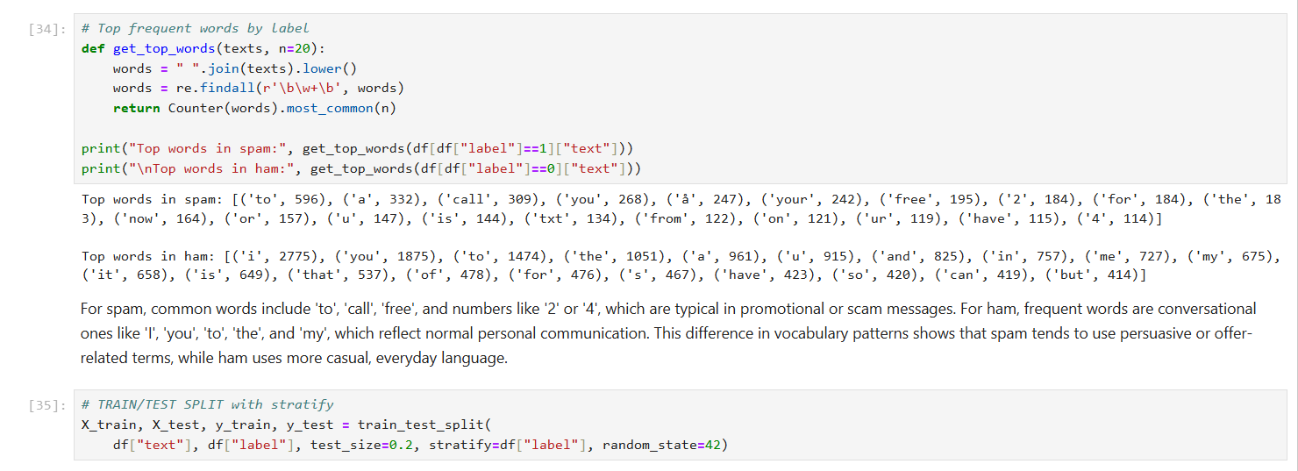
Checking for the Frequent Words in the Data set and Data Splitting

Slide 9
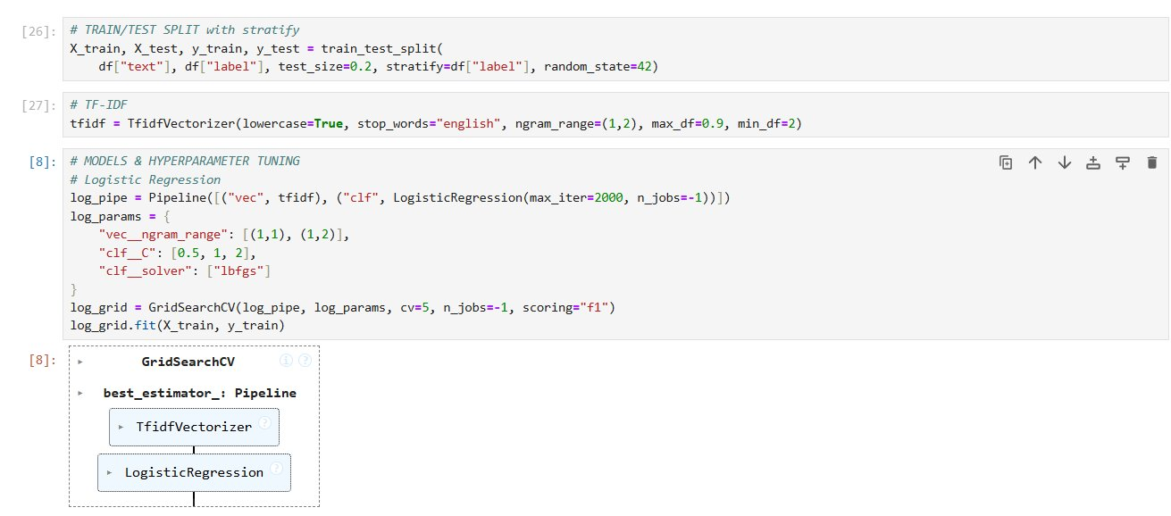
Model Pipeline & Hyperparameter Tuning –Logistic Regression

Slide 10
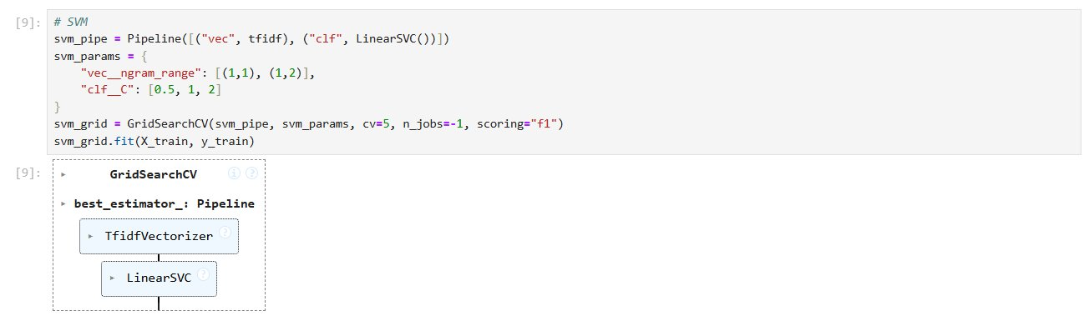
SVM

Slide 11
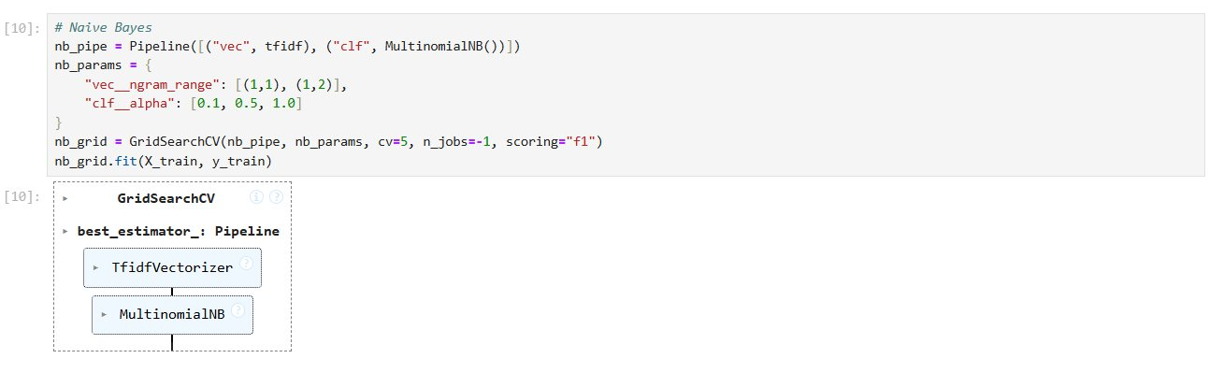
Naive Bayes-Multinomial

Slide 12
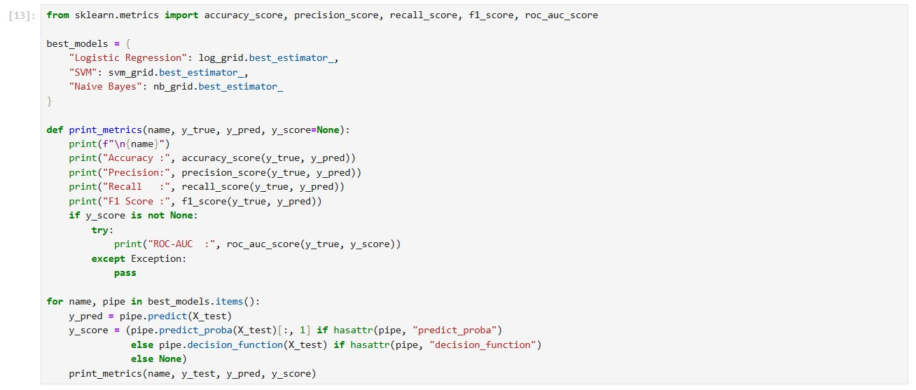
Model Evaluation

Slide 13
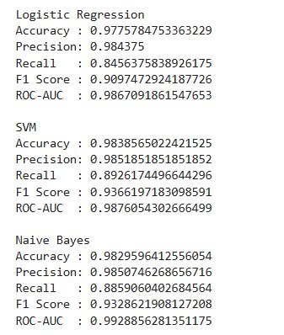
Model Evaluation-Results​

Slide 14
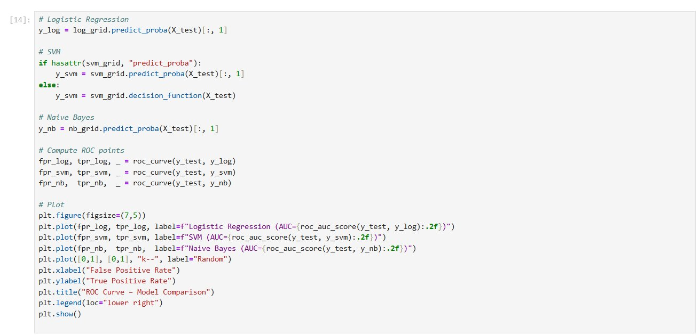
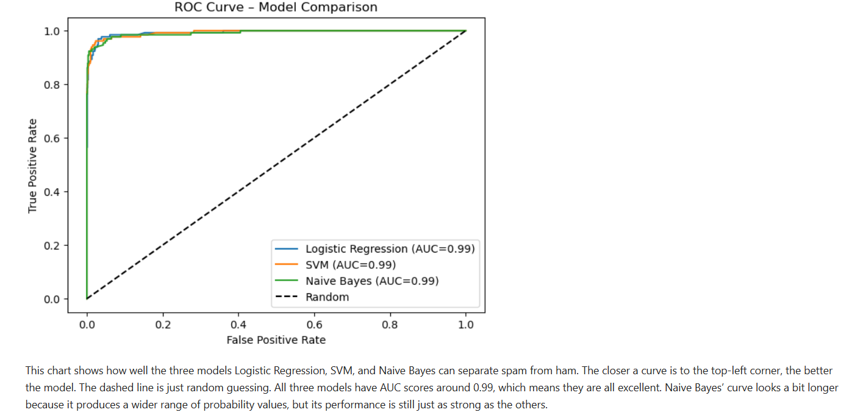
ROC Curve

Slide 15
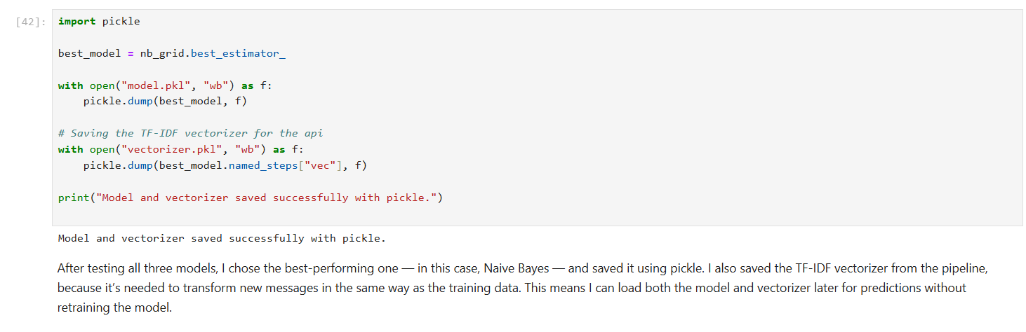
Saving the Best Model & Vectorizer

Slide 16
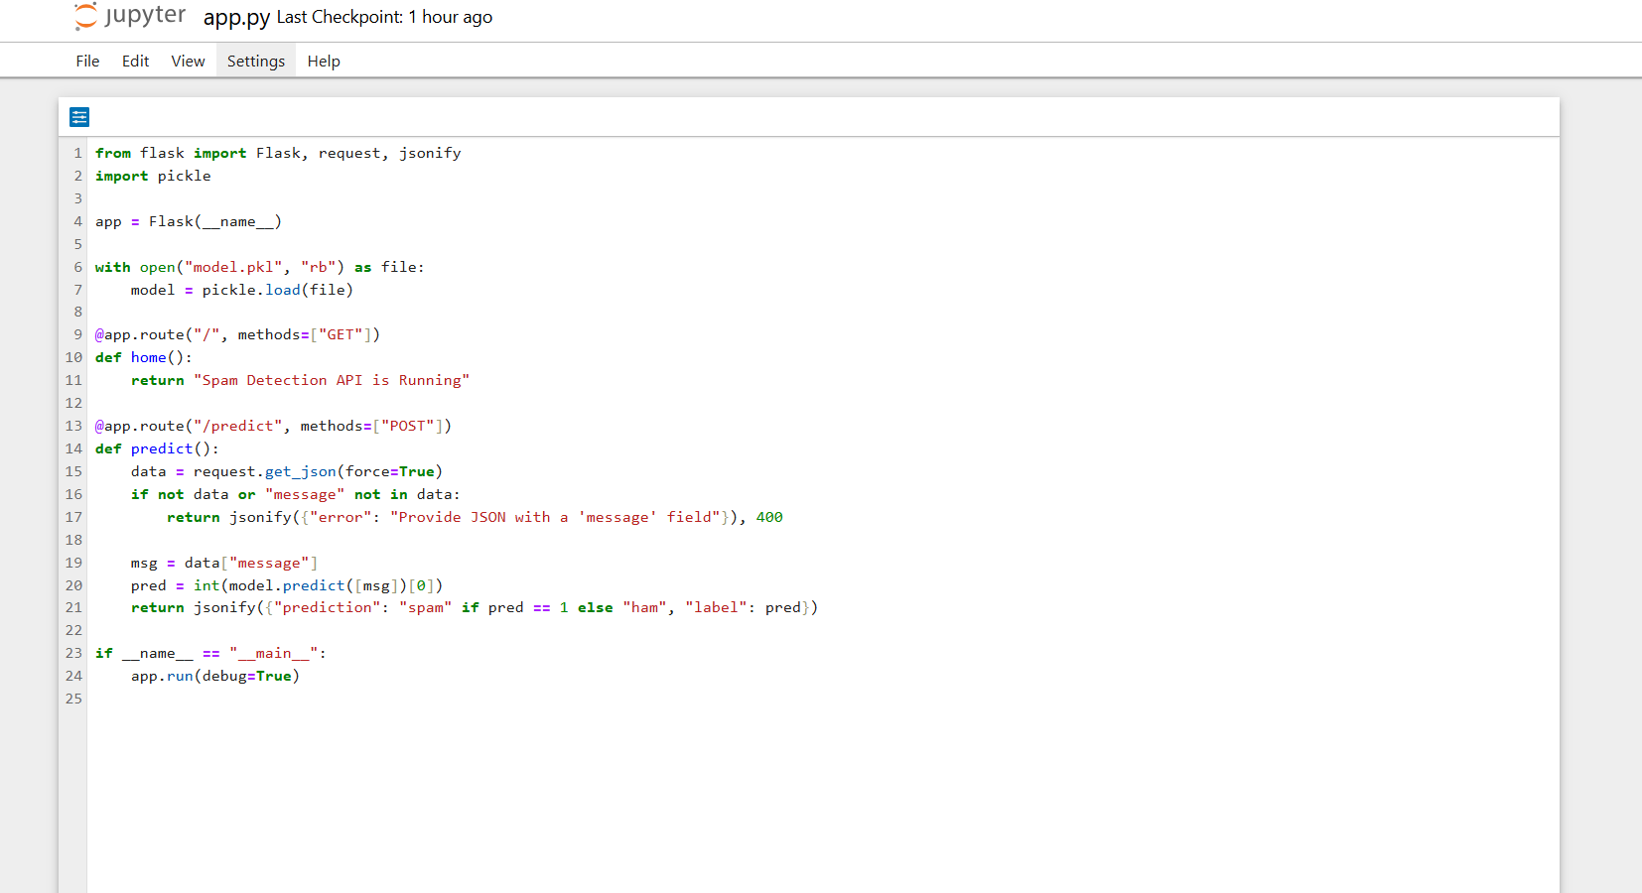
Flask API for Spam Detection

Slide 17
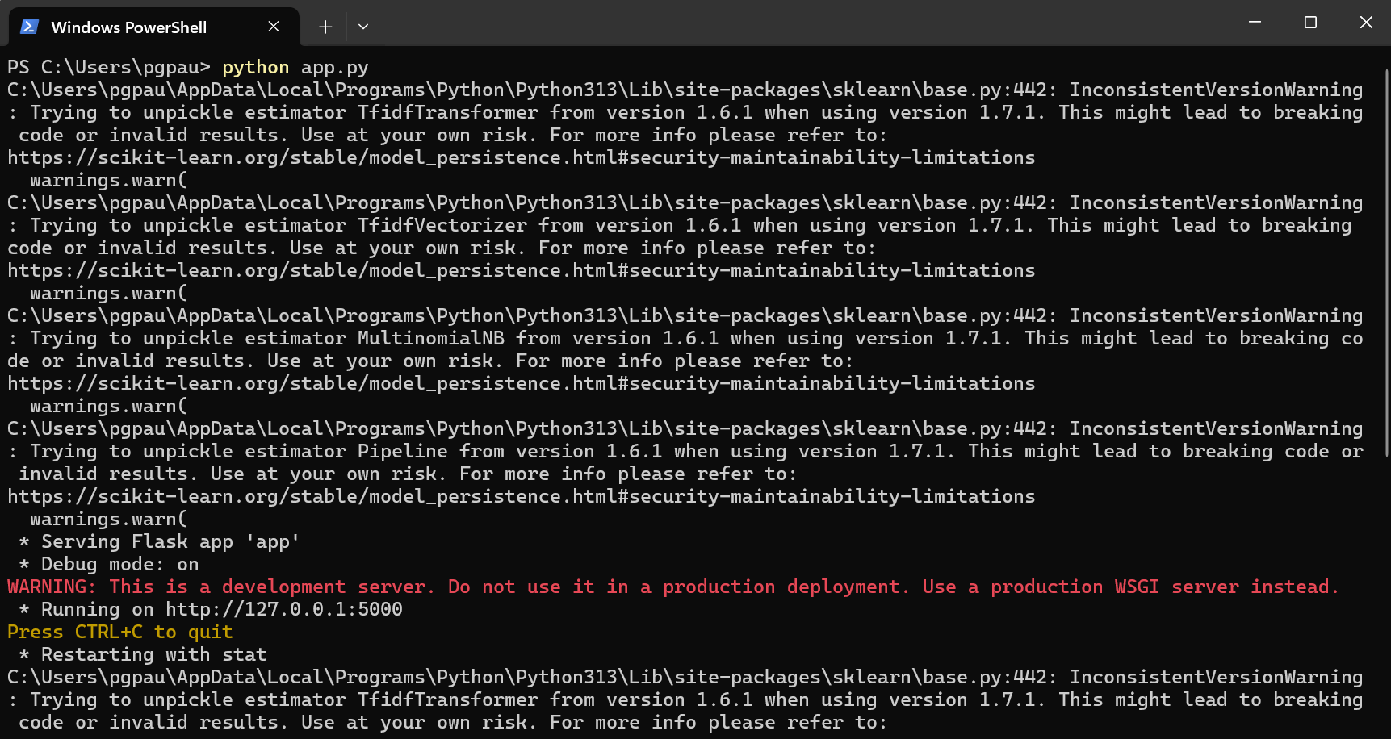
Running the Flask Spam Detection API

Slide 18
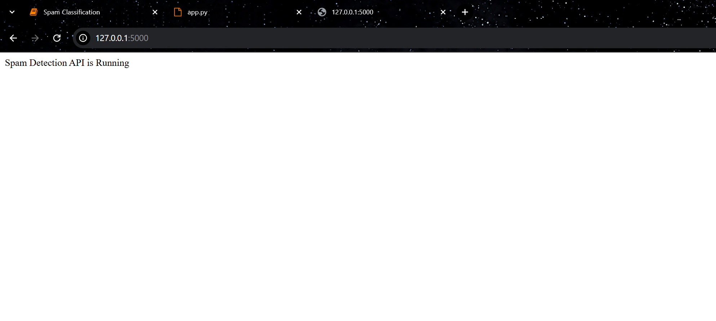
Flask API Running on Default Localhost IP

Slide 19
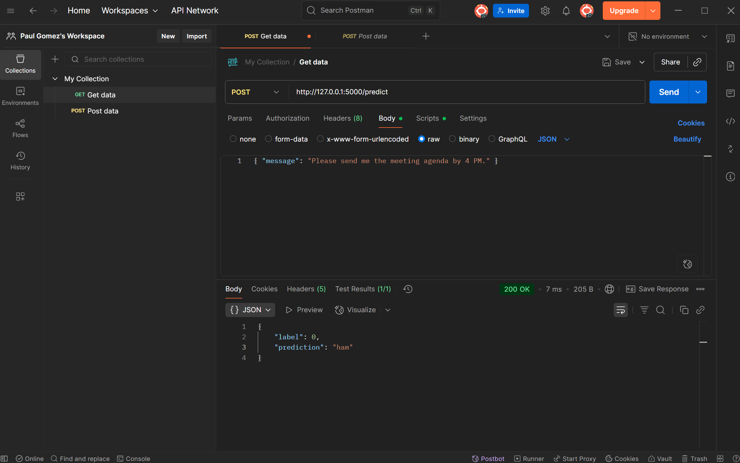
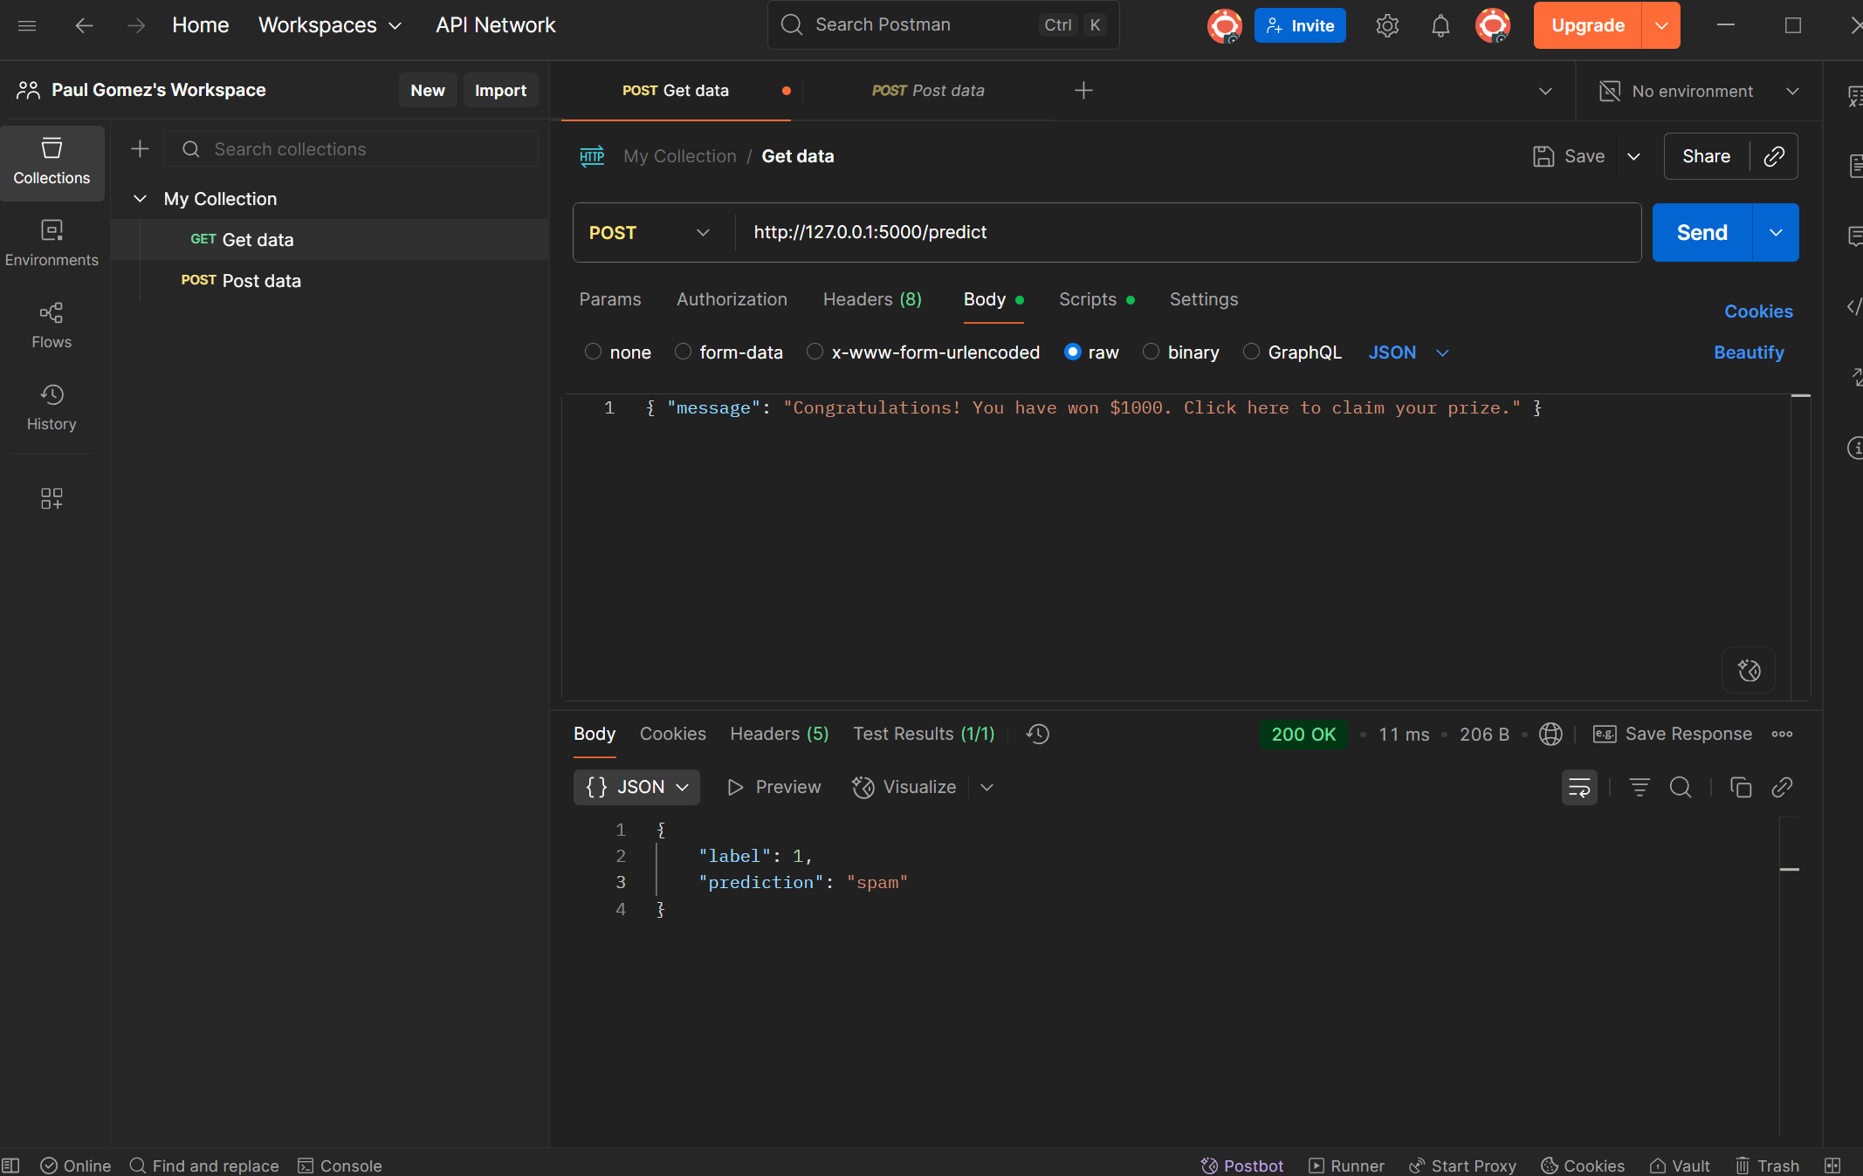
Post Man

Slide 20
GIT HUB
https://github.com/pauljayaprakash/Machine_Learning_Frameworks_Final_Project

Slide 21
Thank you

